Slide 1

Week at A Glance for Science
February
13-17
Solar System and Beyond

Slide 2
February 13-17
S6E1. Obtain, evaluate, and communicate information about current scientific views of the universe and how those views evolved.
a. Ask questions to determine changes in models of Earth’s position in the solar system, and origins of the universe as evidence that scientific theories change with the addition of new information. (Clarification statement: Students should consider Earth’s position in geocentric and heliocentric models and the Big Bang as it describes the formation of the universe.)
b. Develop a model to represent the position of the solar system in the Milky Way galaxy and in the known universe.
c. Analyze and interpret data to compare and contrast the planets in our solar system in terms of: • size relative to Earth, • surface and atmospheric features, • relative distance from the sun, and • ability to support life.
d. Develop and use a model to explain the interaction of gravity and inertia that governs the motion of objects in the solar system.
e. Ask questions to compare and contrast the characteristics, composition, and location of comets, asteroids, and meteoroids.

Slide 3
 | Monday | Tuesday | Wednesday | Thursday | Friday
Focus Standard(s) | S6E1.c | S6E1.c | S6E1.c | S6E1.c | S6E4d,e
Learning Target(s) | Planets (size,distance, composition) | Planets (size,distance, composition) | Planets (size,distance, composition) | Planets (size,distance, composition)
Opening | WB Chapter 19 | WB Chapter 19 | WB Chapter 19 | WB Chapter 19
Work Session | Solar System worksheet; order of Planets | Solar System worksheet; order of Planets |  | Solar System Video; Planet Powerpoint; Quiz #5 (Weather Map)
Closing | TOD | Think-Pair-Share | TOD | Group Discussion
Minor Assignments Due |  |  |  | Quiz #5: S6E4.a,d
Major Assignments Due
Current Relearning & Reassessment Assignments (with due dates) |  | PowerUP Worksheet due Fen 22 (Solar System size, distance, atmosphere)
Vocabulary
Upcoming Major Assignments |  | Science Fair Projects

Slide 4
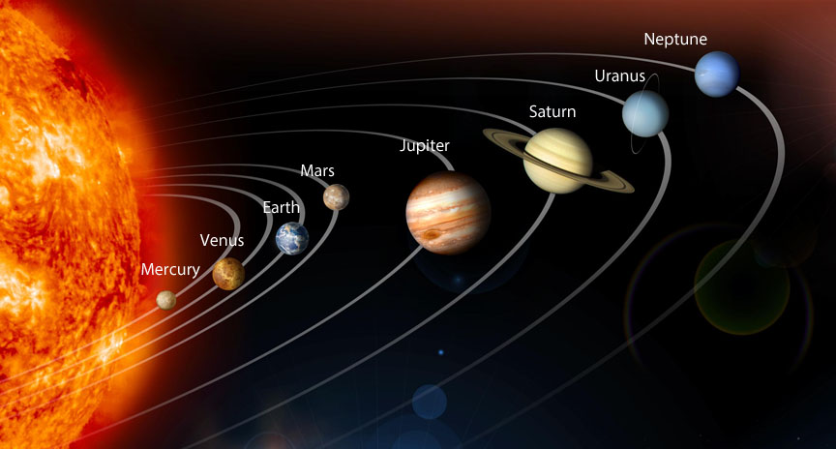

Slide 5
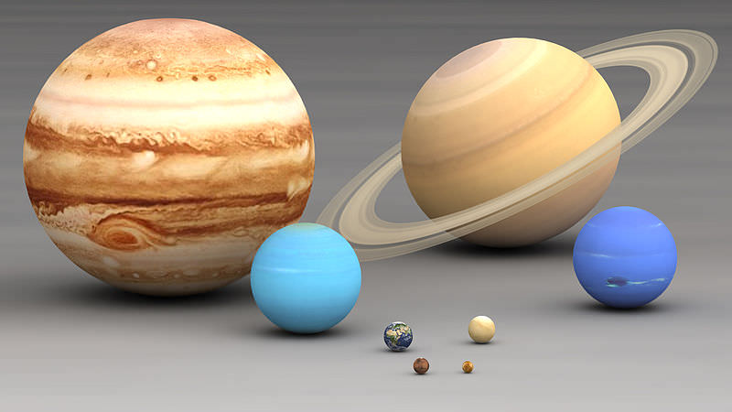
Relative Size

Slide 6
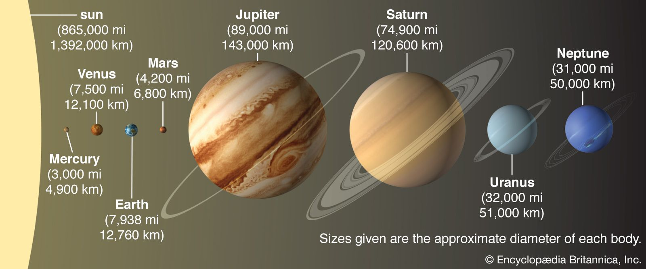
Relative Distance

Slide 7
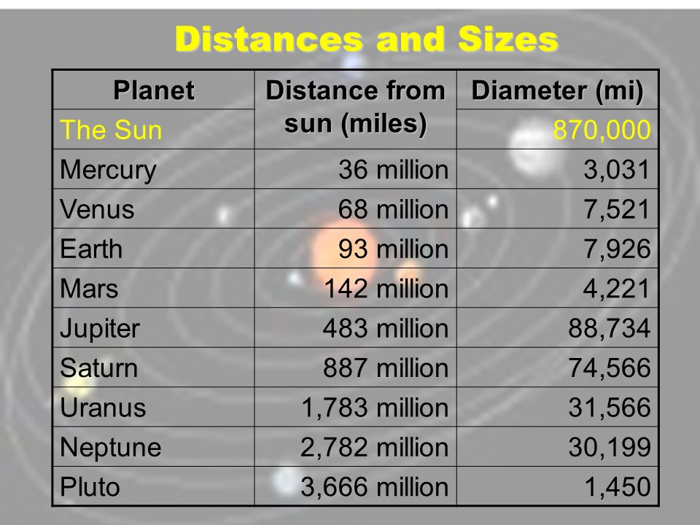

Slide 8
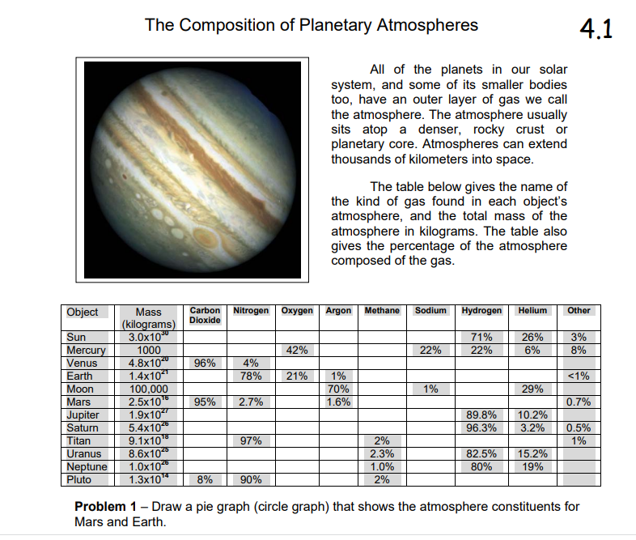

Slide 9
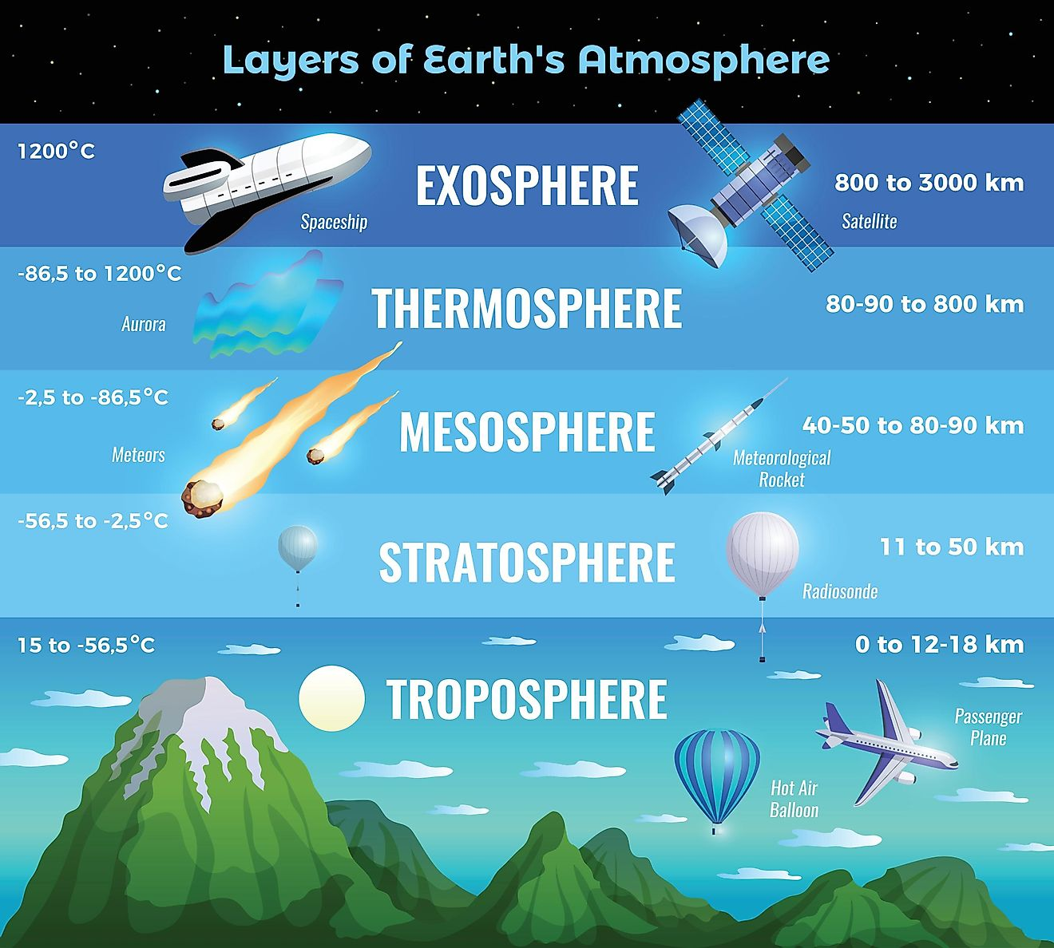

Slide 10
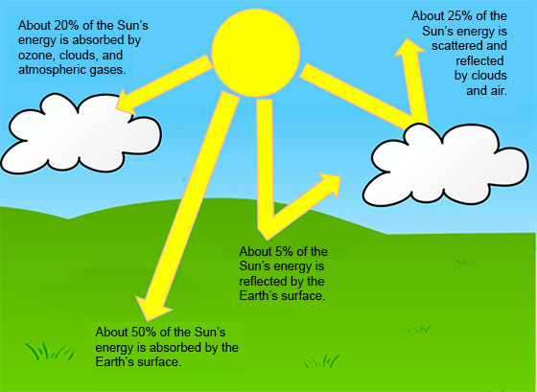

Slide 11
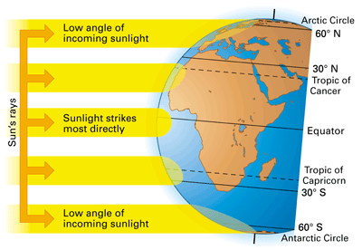

Slide 12
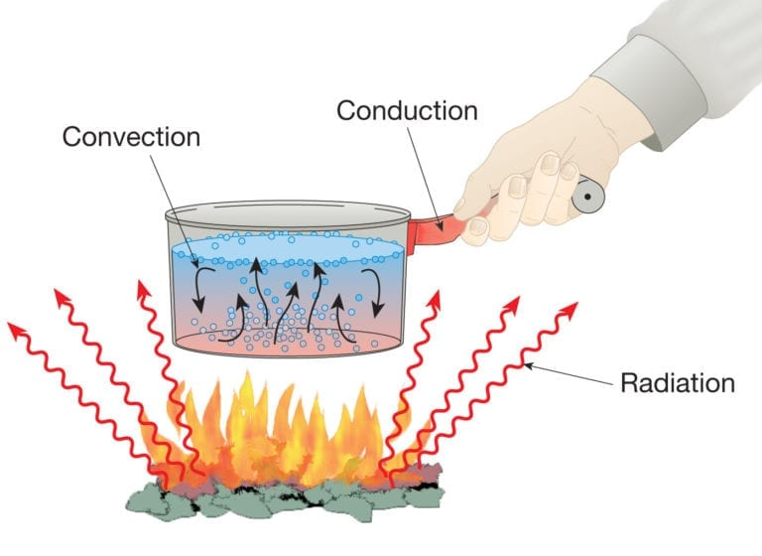

Slide 13
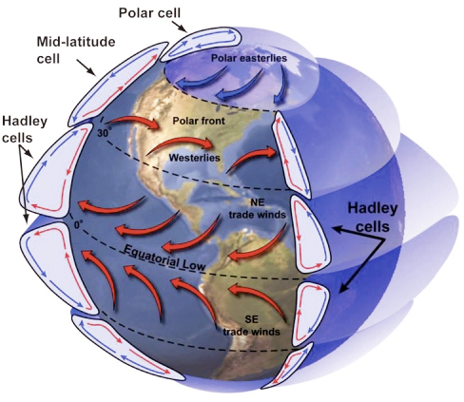
Global Wind Explained
The illustration below portrays the global wind belts, three in each hemisphere. Note that the U.S. lies primarily in the Westerly Wind Belt with prevailing winds from the west. Each of these wind belts represents a "cell" that circulates air through the atmosphere from the surface to high altitudes and back again. The cells on either side of the Equator are called Hadley cells and give rise to the Trade Winds at Earth's surface. How do we explain this pattern of global winds and how does it influence precipitation?

Slide 14
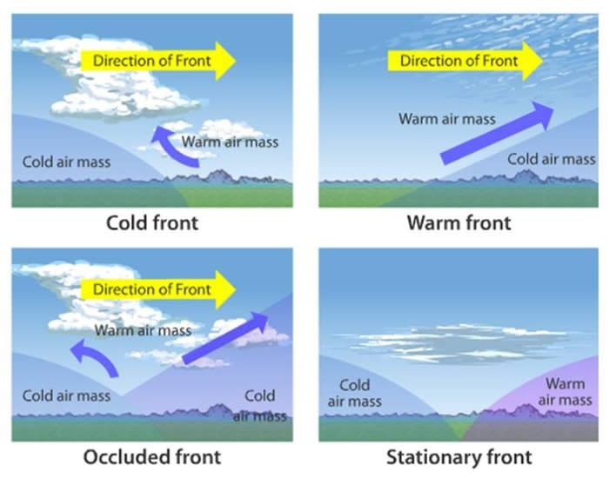

Slide 16

Students will have 15 minutes of Homework each evening.
4 Squares (usually a drawing)
Rock Cycle Puzzle
Workbook Pages
Powerpoint Study Guides
Study Notes or Study Guides
Watch Videos from Week at a Glance

